Slide 1
PART 7 – ATTITUDE/CHAIN OF COMMAND/ WRITING A NARRATIVE/ END OF YEAR REPORTS/TAKING THE CHALLENGE GUIDE TO THE AMERICAN LEGION AUXILIARY DEPARTMENT OF OHIO LEADERSHIP
Prepared by Pam Bates
Department Leadership Chairman
Revised September 2021

Slide 2
Mini Courses Provided
PART 1 THE UNIT
PART 2 THE DISTRICT
PART 3 THE DEPARTMENT
PART 4 CONDUCTING A MEETING
PART 5 PROTOCOL & CONDUCT
PART 6 THINKING ABOUT BEING UNIT/DISTRICT/DEPARTMENT LEADER
PART 7 ATTITUDE/CHAIN OF COMMAND/
WRITING A NARRATIVE/ END OF YEAR REPORTS/TAKING THE CHALLENGE
In reading all the Parts, you will find that there is repetition in many areas. This is done because it doesn’t matter at what level you are working, much of the information is the same.

Slide 3
MISSION & VISION STATEMENT
MISSION
In the spirit of service, not self, the mission of the American Legion Auxiliary is to support The American Legion and to honor the sacrifice of those who serve by enhancing the lives of our veterans, military, and their families, both at home and abroad.
For God and Country, we advocate for veterans, educate our citizens, mentor youth, and promote patriotism, good citizenship, peace and security
VISION
The vision of the American Legion Auxiliary is to support The American Legion while becoming the premier service organization and foundation of every community providing support for our veterans, our military, and their families by shaping a positive future in an atmosphere of fellowship, patriotism, peace and security.

Slide 4
Setting the Example
If we don’t conduct ourselves as knowledgeable and informed members – we cannot expect to tell others “WHO WE ARE AND WHAT WE DO”.
If we don’t teach and inform our members the correct protocols and traditions, we cannot expect to have good, informed and efficient meetings.
READ YOUR GOVERNING DOCUMENTS
These power point presentation PARTs will provide some basics at Unit, District and Department levels.

Slide 5
VARIOUS TOPICS
ATTITUDES
CHAIN FOR COMMUNICATING
MID & END YEAR REPORTS
WRITING A NARRATIVE STORY
TAKING THE CHALLENGE
THANK YOU
PREPARED BY: PAM BATES, DEPARTMENT LEADERSHIP CHAIRMAN
Notes:
To be used with the ALApowerpoint Correspondence Course Narrative.

Slide 6
ATTITUDES ARE CONTAGIOUS … IS YOURS WORTH CATCHING
NEGATIVE ATTITUDE |  | PROACTIVE ATTITUDE
We've never done it that way before. |  | We have the opportunity to be first.
It's too complicated. |  | Let's look at it from a different angle.
We don't have the resources. |  | Necessity is the mother of invention.
It will never work. |  | We'll give it a try.
There's not enough time. |  | We'll reevaluate some priorities.
We already tried it. |  | We learned from the experience.
There's no way it will work. |  | We can make it work.
It's a waste of time. |  | Think of the possibilities.
It's a waste of money. |  | The investment will be worth it.
We don't have the expertise. |  | Let's talk with those who do it.
Our members won't go for it. |  | Let's show them the opportunities.

Slide 7
ATTITUDES ARE CONTAGIOUS … IS YOURS WORTH CATCHING
NEGATIVE ATTITUDE |  | PROACTIVE ATTITUDE
The way we do it is good enough. |  | There's always room for improvement.
We don't have enough money. |  | Maybe there is something we can cut.
We're understaffed. |  | We're a lean machine.
We don't have enough room. |  | Temporary space may be an option.
We don't have the equipment. |  | Maybe we can sub it out.
It's not going to be any better. |  | We'll try one more time.
It can't be done. |  | It'll be a challenge.
No one communicates. |  | Let's open the channels.
Isn’t it time to go home? |  | Days go by quickly around here.
I don't have any idea. |  | I'll come up with some alternatives.
Let someone else deal with it. |  | I'm ready to learn something new.
We're always changing direction. |  | We're in touch with our members.

Slide 8
ATTITUDES ARE CONTAGIOUS … IS YOURS WORTH CATCHING
NEGATIVE ATTITUDE |  | PROACTIVE ATTITUDE
Our Units won't buy it. |  | We'll do better at educating them.
Our Department is the wrong size. |  | We're perfect for this project.
It doesn't fit us. |  | We should look at it.
It's contrary to policy. |  | Anything's possible.
It's not my job. |  | I'll be glad to take the responsibility.
I CAN’T. |  | I CAN.

Slide 9
CHAIN FOR COMMUNICATING
Please DO NOT CONTACT National Directly—Follow the procedure below
If your Unit has questions about auxiliary do’s and don’ts or general information, please follow the CHAIN OF COMMAND to eliminate confusion:
Unit President District President
District President Department President
If your Unit needs help with a program contact:
District Chairman Department Chairman
You may contact the Department Secretary if you have questions. She may answer or direct them to the appropriate individual.

Slide 10
HOW TO COMPLETE A MID & END YEAR REPORT
Review & Read the OHIO Plan of Action
Mailed to the Unit President to distribute to the Unit Chairman
Find online at www.alaohio.org
Request an email copy from the Department Chairman
Determine objectives to accomplish during the year
It is IMPORTANT to read thoroughly and completely as each program has different criteria. Some require dollar values; number of volunteers; number of veterans served (be specific - “many” is not numerical); impact reports some require totally different information. One size does not fit all.

Slide 11
HOW TO COMPLETE AN END YEAR REPORT
Compile data, total numbers, activities from your members and treasurer and then determine where the information fits the Ohio Plan of Action objectives and the Impact Report.
If an activity crosses several Programs, decide to use the numbers on one or distribute them across the Programs that are involved.
Write the narrative, and forward it by deadline to the individual who is to receive the report. This is listed in the Plan of Action.
If we as department chairmen do not receive information from our units, we cannot report “What Ohio Does” for the programs.

Slide 12
WRITING YOUR UNIT NARRATIVE STORY
The word narrative often panics people. Don’t let it! You are really writing a story about what your unit did or if it’s a member specific award, what they did for the program.
Think of a member you have not seen for a long time. Here’s your chance to tell that member what has been happening in the unit for the year.
Review and read the awards in the OHIO Programs Action Plan. Each has different criteria. Some require impact reports and the National Report Form in order to be considered. READ CAREFULLY!

Slide 13
WRITING YOUR UNIT NARRATIVE STORY
Where to start:
Plan ahead - check the Programs Action Plan and decide what the unit would like to accomplish and what goals the unit needs to accomplish to achieve any awards. Remember most units cannot do all the programs. Pick and choose what your unit does best.
Try and keep a journal of what your unit and members have done through the year.
Check the questions on page one. Use those to help write your narrative.
Check the Objective Goals and Action Steps to achieve those goals.

Slide 14
WRITING YOUR UNIT NARRATIVE STORY
Where to start: (continued)
Once you have gone through all the POA questions, objectives, steps and determine the activities the unit has accomplished start writing…who, what, when, where and how.
Be very specific in your writing. Try to write in the 3rd person…not my or I, but the unit, chairman or member. If the award is member specific, you will have to mention the name.
Keep in mind that the Department Chairman, are looking for the criteria specific to their program. If in doubt what to write, contact the Department Chairman and ask for advice.
Trust me…you will not get it right on the first writing…it may take 3 or more times…start early…write then walk away…come back reread and rewrite…suggest you put a Revision on each copy just in case you removed something and now you want it back.

Slide 15
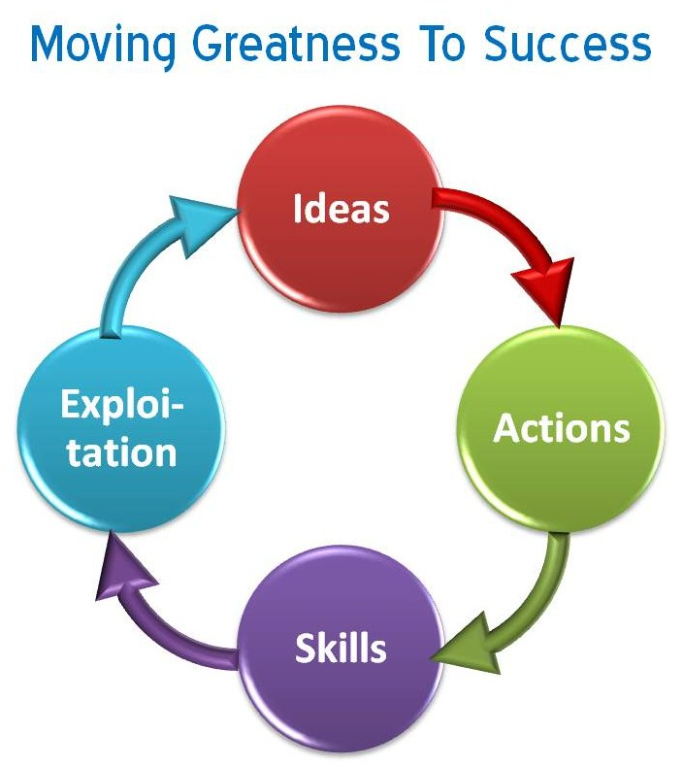
IT’S UP TO YOU TO MAKE OUR ORGANIZATION SUCCESSFUL…CAN YOU MEET THE CHALLENGE?!

Slide 16
You have come to the end of 7 mini leadership slideshows.
I hope you were able to use the information provided.
If you have any questions, contact your Department Leadership Chairman.
If you have any recommendations for other topics or comments to enhance the current 7 mini leadership slideshows, contact your Department Leadership Chairman.

