Slide 1

GoodWill Hunting finding your inner-kindness

Slide 2
TODAY’S AGENDA
Defining goodwill (finding your inner-kindness)
How incivility impacts our organization
Dealing with civility issues
Email 101
Q&A

Slide 3
Good Will=Civility:
What does it mean to you?
Let’s brainstorm your definitions!

Slide 4
Defining Civility
“Civility is claiming and caring for one’s identity, needs and beliefs without degrading someone else’s in the process.”
“Civility is a conscious awareness of the impact of one’s thoughts, actions, words and intentions on others.”
“Civility training is meaningless unless you treat the person right in front of you, right now, in the right way.”
“Civility is consistently treating people with consideration and respect and valuing the culture and humanity of others.”
Notes:
The first comment is from the Founders of the Institute for Civility in Government. The second is from The Meeting Institute. Finally, the third is from author R. Sutton.

Slide 5

Understanding our Volunteers
3.5 billion women in the world
160 million women in the United States
Notes:
There are 3.5 billion women in the world, 160 million women in the United States…and we’re all different. We come from different backgrounds, we have different ideas, we’re motivated by different things, we react differently to situations. So there is no cookie-cutter, one-size-fits-all approach when dealing with our members. That’s because we are all unique and different. How cool is that really? It would be very boring if we all had no opinions, no ideas and thought the same way on everything. We are all beautiful in our own way. Understanding the general types of people, what motivates them and the best way to communicate with them can help us all when dealing with conflict.

Slide 6
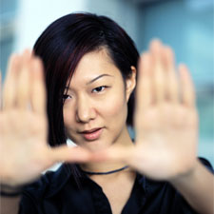

Meet Our Members
Analytical
  Projects are valuable, and their work makes a difference.
  Leader who excels in a particular area and expertise.
  Reward THEM.
Structural
  Their work aids the organization’s progress.
  Leader who is organized, competent and good with details.
  Reward timely, in writing and speak specifically about the task.
Social
  Want to feel personally valued, and they impact the project.
  Go the extra mile for a leader who expresses faith in them.
  Reward in person and with a gesture that is from the heart.
Notes:
We can readily define some specific traits that are recognizable in the general population:
Analytical:
They want to know that a project is valuable and that their work makes a difference to its success.
They need a leader who excels in a particular area and whose expertise they believe benefits the group.
If they have done a tremendous amount of work on their own, don’t expect them to be happy if you reward the whole team!
Structural:
People who are “structural” by nature want to know their work aids the organization’s progress.
They prefer a leader who is organized, competent and good with details.
They like to be rewarded in writing, in a timely manner and in a way specific to the task.
An encouraging email is appropriate to communicate with them.
Social:
Social people want to feel PERSONALLY valued and that what they are doing has an impact on a project.
They go the extra mile for a leader who expresses faith in their abilities.
They prefer to be rewarded in person with a gesture that is from the heart
If your own preference is for written communication, send a handwritten note to a particularly social member.

Slide 7
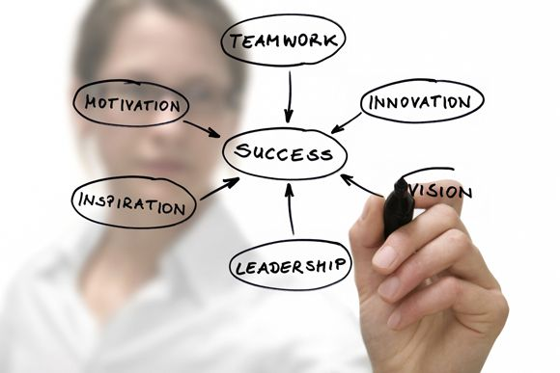
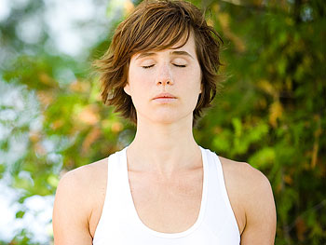
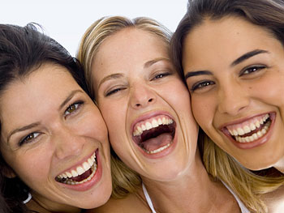
Meet More of Our Members
Innovative
  Must “buy in” to a cause.
  “Big picture” matters most.
  Reward with something unconventional and imaginative.
Quiet
  Don’t need a lot of fanfare.
  Appreciate private, one-on-one encouragement.
Expressive
  Feel motivated when assignments are openly discussed and an open door is available.
  Public recognition with pomp and ceremony.
Notes:
Innovative:
Volunteers must buy in to a cause.
To them, the big picture matters more than the individual who is leading the charge.
They prefer to be rewarded with something unconventional and imaginative and would find a whimsical token of your esteem very meaningful.
Quiet:
These volunteers don’t need a lot of fanfare; they appreciate private, one-on-one encouragement.
Expressive:
These members feel more motivated when assignments are openly discussed and an open door is available; they’ll never demand a reward or recognition, so it’s up to you to offer it.

Slide 8

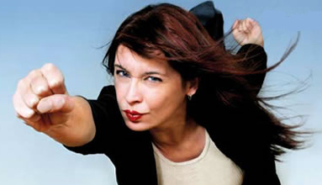
…and Meet Still More of Our Members
Peacekeepers
  Hope everyone moves in the same direction.
  Will never demand a reward/recognition, so it’s up to you to offer it.
Hard-drivers
  Independent thinkers.
  If they agree, will be highly motivated.
  They will let you know how to reward them. FYI: Give it to them RIGHT AWAY.
Focused
  Need confidence in the leader, or attention will stray.
  Want to know up front what kind of reward they can expect.
Notes:
Peacekeepers hope everyone will move in the same direction; they’ll never demand a reward or recognition, so it’s up to you to offer it.
Hard-drivers are independent thinkers. If they agree with you, they will be highly motivated. They will let you know what they’d like as an extrinsic reward, and they tend to want whatever it is right away.
Focused team members must have confidence in the leader and in the project, or their motivation may falter. They want to know up front what kind of reward they can expect. Make sure you follow through on whatever is promised.

Slide 9
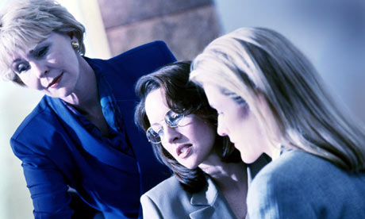
…and Finally
Flexible
  Go along with the team.
  As long as a project does not contradict with their morals or beliefs, they’re in.
  Any kind of recognition.
10 different and unique personality types who are motivated by different elements
+
5 generations at work with each other
=
Melting pot of women who are looking to you as leaders to show them the way!
Notes:
Flexible: They go along with the team. As long as a project does not contradict their morals or beliefs, they are IN; They are happy with any kind of recognition.
You have just met our volunteers. Throw in a healthy dose of five generations at work with each other, and you’ve got a melting pot of women who process information differently, are motivated for different reasons and are looking to you as leaders to show them the way. How’s that for pressure?!
In order to have a strong Auxiliary, we need to have all of these different types of women working our mission. So, when conflict arises, it’s up to you to do everything you can do to diffuse the situation, retain that member and preserve the dignity for both of you. Knowing a little bit about what you’re dealing with might help you to employ the best tactic.

Slide 10

…and Finally
Flexible
  Go along with the team.
  As long as a project does not contradict with their morals or beliefs, they’re in.
  Any kind of recognition.
10 different and unique personality types who are motivated by different elements
+
5 Generations at work with each other
=
Melting pot of women who are looking to you as leaders to show them the way!
Notes:
(pause for laughter)

Slide 11
People We Admire
Please write down the names of five people you admire.
Notes:
The field is wide open. You can include famous people, people from business, social media, politics, technology, the sciences, American Legion Auxiliary, coworkers, neighbors -- anyone.

Slide 12
People We Admire
Now, write down an adjective or a few words to describe why you admire each of these people.

Slide 13
People We Admire
Now, spend a few minutes comparing your notes.

Slide 14
A Few “inner-kindness” Terms
Respect for others Equality
Care Sincerity/honesty
Community service Awareness
Tact Trustworthiness
Consideration Listening
Kindness Compassion
Fairness Peace
Self-control Please and thank you
Tolerance Refusal to gossip
Etiquette Helpfulness

Slide 15
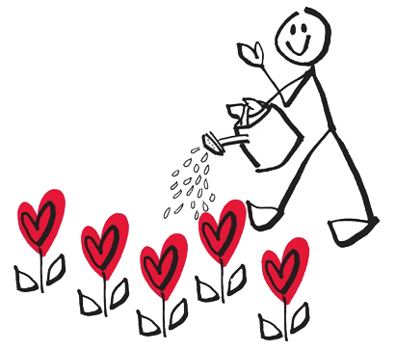
Why hunt for your good will?
Protecting relationships
Controlling emotions
Look in the mirror
Waste of energy
No hangover
Don’t stoop
Spread love
Notes:
Why hunt for your goodwill? [Ask for suggestions from the audience…capture on a white board] Then show our choices…
Protecting relationships: When valued, there is power in taking initiative to repair it. Acting with calmness and integrity in the face of hurtful behavior is empowering, healthy and strong.
Controlling emotions: Anger feeds anger, so if you respond like a crazy person, people will see YOU as the crazy person. Respond with integrity, and others will see the other person as the unhealthy one.
Look in the mirror: When you freak out in response to someone else’s freakout, that person ignores your message and simply thinks, “You think I’m crazy? Look at YOU!” Your poor behavior gets in the way of them seeing their own poor behavior. No one comes out in tact.
Waste of energy: Why not direct your energy in other ways? When you take the high road, you’re saving yourself from wasting energy and giving yourself high blood pressure and obviously stress. Who needs high blood pressure and more stress?!
No hangover: When you can stay calm in the most difficult of moments, you avoid the “reactivity hangover.” There’s no shame, self-hatred, regret or embarrassment about what you did or said. You can hold your head high and feel good about yourself. You can sleep at night.
Don’t stoop: When you stoop to the other person’s level, you are off. They got you. Take the high road knowing that the poor behavior of others is NOT a green light for your own poor behavior.
Spread love, not hate: There is enough terrorism in our world. Don’t allow negativity to spread. It will affect your mood and the state of mind of those around you. The best and most productive environment is one that needs to foster positivity and optimism.
Does anyone have any other great reasons for taking the high road? [audience participation…capture on white board]

Slide 16
Benefits of finding your inner-kindness
Pride
Leading by example
Peace
Moving On
Reputation
Notes:
There are many benefits to being kind:
sense of pride at not stooping to the level of others
demonstrating that you are someone who will not bad-mouth someone else, even the one who is doing it to you
greater peace in avoiding people who cause you pain
moving on quicker from the situation
gaining a better reputation as a leader and friend - others will see that you aren’t going to share any arguments publicly, and friends will view you as someone who will keep your relationship in a safe place
There are some people who know how to get you angry. A person who has self control, both mentally and emotionally, is able to keep herself cool rather than losing it like the Incredible Hulk. And let’s face it: Who here wants to call the national president and explain why she lost her cool, said naughty words and didn’t use good judgment when engaging other members? NOT ME. Those who keep their cool are always more respected by the team.

Slide 17

How to find your good will
Tick Tock
Fact vs. Fiction
Be Aware
You First
A Way Out
Notes:
OK, so we know there are many good reasons to show kindness. But just how do we do it? Anybody out there have any ideas? [Encourage audience and capture on white board]
Tick Tock – Take some time before responding to make sure you are in a calm place of mind. Sticks and stones - they really do hurt. Don’t use cursewords or name calling.
Fact vs. Fiction – Stick to the facts only.
Be Aware – Be cognizant of what you’re saying and how it could make your member look bad. In short, don’t attack back with your words, but respond only to the things you wish to clarify.
You First – Allow the other person the first opportunity to state her position. Don’t interrupt, and hear her out. You will get your opportunity.
A Way Out – Build up. It’s always better to build up than tear down. Giving a compliment, meeting someone halfway or giving them a way out are all great strategies to defusing a potentially volatile situation and allowing each the dignity to back up and re-evaluate.

Slide 18
Body and Verbal Cues
Remember non-verbal communication!
Think about silence as a choice, not as a void waiting to be filled.
Saying “no” to someone may be saying “yes” to yourself.
Accept and give praise.
Respect others’ opinions.
Respect others’ time and space.
Notes:
We can offend others without bodies. Keep fingers at a safe distance from your mouth, ears and nose. Don’t spit. Don’t scratch yourself.
A few “no “ phrases:
No thank you.
No, I don’t think that would be a good idea.
No, that’s not what I had in mind.
No, I’m not comfortable with that.
A compliment is a gift, accepted with thanks. Be sincere. Keep things simple. We need to be tolerant of the fact that opinions may differ from ours, so give them a fair hearing. Attacking an opinion may be viewed as a personal attack. Look for possibilities of agreement, and consider that you might just be wrong. Don’t be afraid to admit that you may not always know the answer. The time of others is as valuable as yours. Have you ever waited and waited at a doctor’s office? Arrive on time, and do not hold others hostage. Keep telephone calls brief. Respect deadlines.

Slide 19
Email Etiquette 101
Hi Susie,
Hope this note finds you well! I received your bulletin yesterday, and it was great. It was informational, and I found the suggestions helpful to my team. I did notice a typo and wanted to bring it to your attention in case you missed it. I know that you are busy and also work full time, so if you need an extra pair of eyes on your documents, I am happy to help. I am a retired school teacher and have plenty of time.
Thanks again for a great bulletin, and I look forward to the next one!
Sincerely,
Millie Helpful
Proud Member of Leaping Lizard Unit 4
Little Rabbit’s Foot, Kansas
Notes:
Lets talk email. How does this email make you feel? [Encourage responses from audience]
Helpful? Disarming? Complimentary? Friendly?

Slide 20
Email Etiquette 101
Who made the SCREW-UP on the bulletin?????!!!!!!!!!!!!!!!!!!!!!!!
Notes:
Wow…how does this one make you feel? [Invite responses from the audience]
Are you talking to me, or was this message meant for someone else?
“Screw-up” -- now that’s professional.
23 exclamation points? I think one would do the trick…thanks.
Just because you didn’t sign your name…am I supposed to really think you sent it?
No member of the American Legion Auxiliary would send an email like this! My thought is that the email address was probably hacked.
Seriously…how does this email make you feel?

Slide 21

Email Etiquette 101
Who made the SCREW-UP on the bulletin?????!!!!!!!!!!!!!!!!!!!!!!!

Slide 22
Email Etiquette 101
Hello Millie,
I hope this note finds you well, and everything is good with you, your family and the team out in Little Rabbit’s Foot. Thank you for reading our bulletin. Our team is working hard to come up with innovative ideas for our members to help promote our great mission of Service Not Self. Your input is valued and appreciated, and I sincerely thank you for taking the time to share your observations. I will be sure to make the necessary correction and send out a new version.
Best wishes for a great day.
Sincerely,
Susie Campbell
Notes:
Here’s my response.
Is this the one I originally wrote and dropped in my drafts folder? No way. There would be flames flicking from my fingers. But no way would I send the one I really wanted to send. Instead, I would think about that phone call I might get from the national president about the snippy and snarky email I sent. So instead, I’m going to sleep well tonight knowing the snippy and snarky one has been drafted, printed, deleted and is now a thing of the past. If you write an email like this, I can guarantee an “oh no” phone call. You will be able to sleep at night. You didn’t offend anyone. No harm, no foul - and Millie doesn’t even know what hit her.

Slide 23
Email Etiquette 101
Know your audience.
Include a courteous greeting and closing.
Spell check.
Multiple usage of !!! or ??? is perceived as rude and condescending.
24-hour rule: Walk away.
Triple-check addresses.
No email is private.
Always end with “Thank You,” “Sincerely,” “Best Regards” – SOMETHING.
Leave politics to politicians.
Grammar counts!
Use a clear, clean font like Arial, Helvetica or Verdana.
Type unto others as you would have them type unto you.
Baker’s dozen tip: When there is a misunderstanding by email, don’t hesitate to pick up the old-fashioned phone to work things out.
Notes:
Know your audience – Use good judgment when sending email to people you don’t know or don’t know well. They can be easily offended if they don’t know your sense of humor. They may not think it’s funny or get the joke.
A courteous greeting and closing help to make your email not seem demanding or terse.
Spell check! We all make mistakes, but try to catch them first. Emails with typos are simply not taken seriously.
Multiple usage of !!! or ??? is perceived as rude and condescending. Only one will get your point across.
If your email is emotionally charged, walk away from the computer and wait to reply. The 24-hour rule has saved me more times then I can count.
Triple-check all of those email addresses. There’s nothing like your boss’s email getting bundled in with all of your Auxiliary girlfriends.
No email is private. I don’t care how many confidentiality statements, “Please don’t forward,” “Keep this between you and me” – understand that no email is private.
If you were handwriting a letter, wouldn’t you end with ”Hope to see you soon” or “Thanks”? Don’t forget this courtesy in email too.
We are a nonpolitical, nonpartisan organization. Forwarding politically charged messages can be damaging. Don’t assume your new best friend shares your point of view.
Try to use good sentence structure. Do your best.
Use easy-to-read fonts like Arial or Helvetica, and you’ll be safe.
The Golden Rule applies to email too.
Technology is great, but Alexander Graham Bell got it right -- there’s nothing like hearing your friend’s voice, her inflection, her tone and her words. If you have an issue, pick up the phone and call.
Anyone have additional email tips they would like to share? [encourage participation and write suggestions on a white board]

Slide 24
Let’s Practice Good Will
A short play!
Notes:
OK…everyone stand up. We’ve been sitting a long time, and thanks for listening to this presentation. Now that everyone is out of their chairs, very slowly turn and look under your chairs. Out there are six envelopes. If you have an envelope, pull it off of your chair and join me on stage. Bring your envelope up here. We will open it together on stage.

Slide 25

Good Will Hunting Found
Questions?
Notes:
Updated from taking the high road presentation. Author unknown. Updated 2014 by Mary Davis.

